Slide 1

Sentiment Analysis of IMDB Movie Reviews
Understanding audience sentiment and its relationship with movie ratings.
Presented by Sarthak Raut & Rutuja Belkare AIML
12/03/2025.

Slide 2

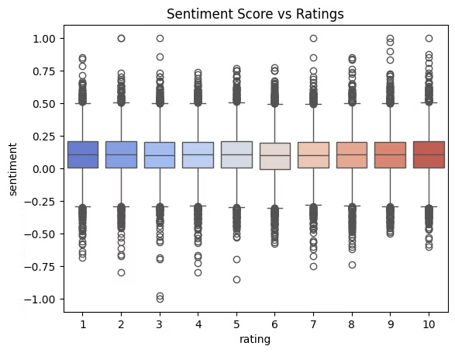
Introduction to Sentiment Analysis
What is Sentiment Analysis?
Why Analyze IMDB Reviews?
Sentiment Analysis is a Natural Language Processing (NLP) technique.
IMDB contains millions of user reviews. It's an ideal dataset.
Helps understand audience perceptions and predict movie success.
It determines emotional tone in text.
Used in customer feedback, reviews, and social media analysis.
The objectives are classifying reviews and visualizing insights.

Slide 3
Dataset and Tools
Dataset Overview
Libraries Used
The dataset is sourced from IMDB movie reviews.
pandas: Data loading & processing
It includes movie reviews (text) and ratings (1-10).
numpy: Numerical computations
matplotlib, seaborn: Data visualization
textblob: Sentiment analysis
wordcloud: Text visualization

Slide 4

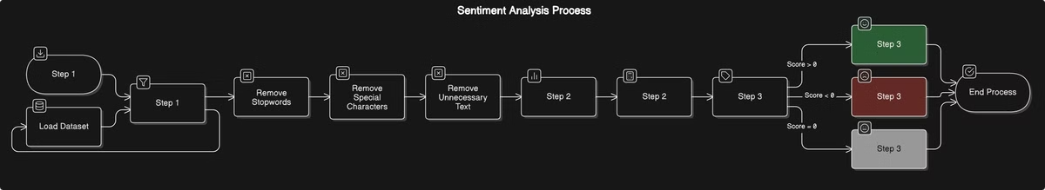



Methodology
Data Loading & Preprocessing
Sentiment Calculation
Sentiment Categorization
Load dataset using pandas.
Use TextBlob to compute sentiment polarity (-1 to +1).
Positive (Score > 0)
Remove stopwords, special characters, and unnecessary text.
Negative (Score < 0)
Neutral (Score = 0)

Slide 5
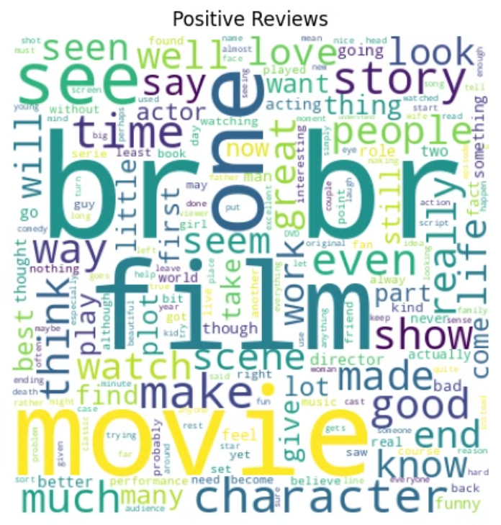
Sentiment Distribution
Sentiment Distribution (Bar Chart)
Word Cloud Analysis
Positive Reviews: love, amazing.
Majority of reviews are positive.
Negative Reviews: boring, worst.
Negative reviews are fewer.
Negative reviews correlate with low ratings.

Slide 6
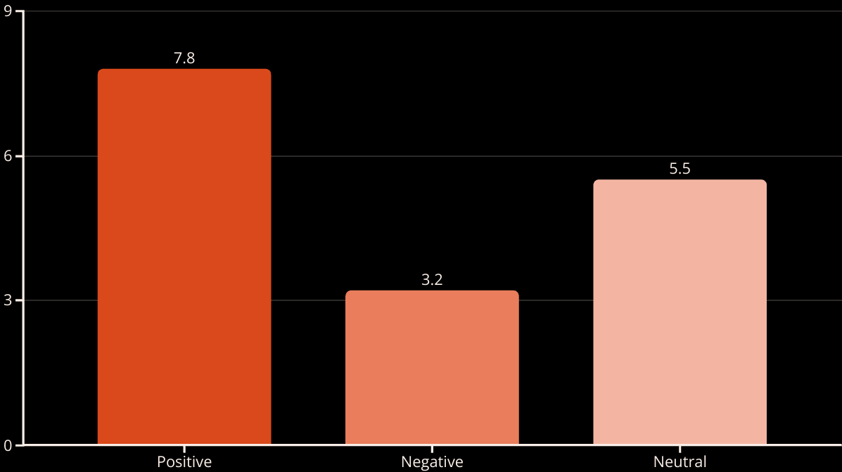
Sentiment vs. Ratings
The chart shows sentiment category vs. rating distribution.

Slide 7
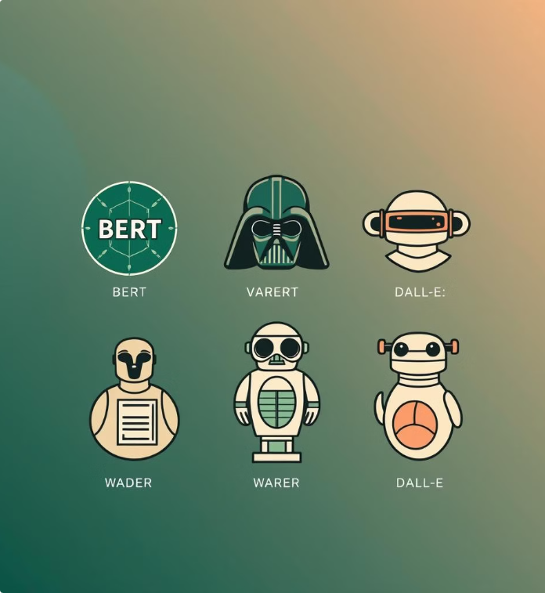
Limitations & Improvements
1
Limitations
Basic NLP model - TextBlob lacks context.
Doesn't detect sarcasm effectively.
2
Future Enhancements
Use Advanced NLP models like BERT, VADER.
Improve Context Handling.

Slide 8
Conclusion & Thank You
Sentiment analysis shows a strong correlation.
Word clouds highlight frequently used words.
Insights can help filmmakers and platforms.
Sentiment analysis provides valuable insights.
It can help improve movie content.
Thank You!

